Slide 1
2017 Stop, Question, and Frisk Data

Slide 2
NYC Stop Question and Frisk (SQF)
Implemented in 2002
97,296 incidents
Between 2003 and 2011 incidents increased dramatically
Maxing out at 685,724 in 2011
Since 2011 there has been a decrease in SQF incidents
Numbers have dropped dramatically after 2013

Slide 3
Questions
What crimes are related to SQF?
Violent/nonviolent
What is the relationship between overall SQF for NYC and SQF for the five individual boroughs?
Do trends look the same between boroughs?
Do the borough trends match the overall city
Are there trends across days of the week, and months of the year for SQF?

Slide 4
What are the trends in SQF data?
There would be an uptick in SQF incidents during the summer months
Based on previous data 2017 SQF would continue a trend of ineffectiveness
Majority of incidents occur without an arrest or citation

Slide 5
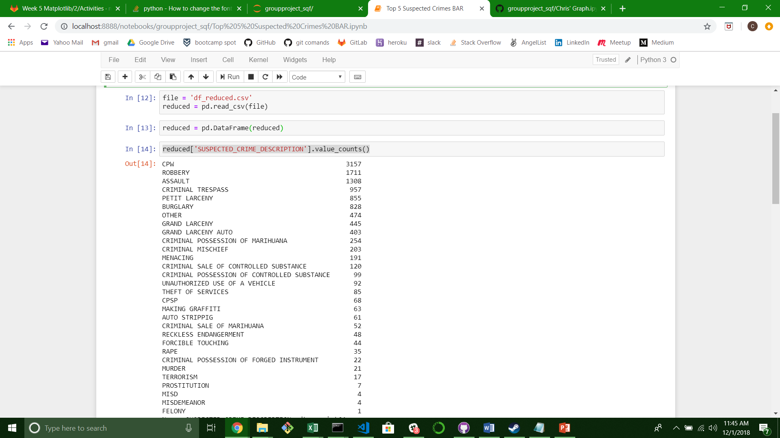
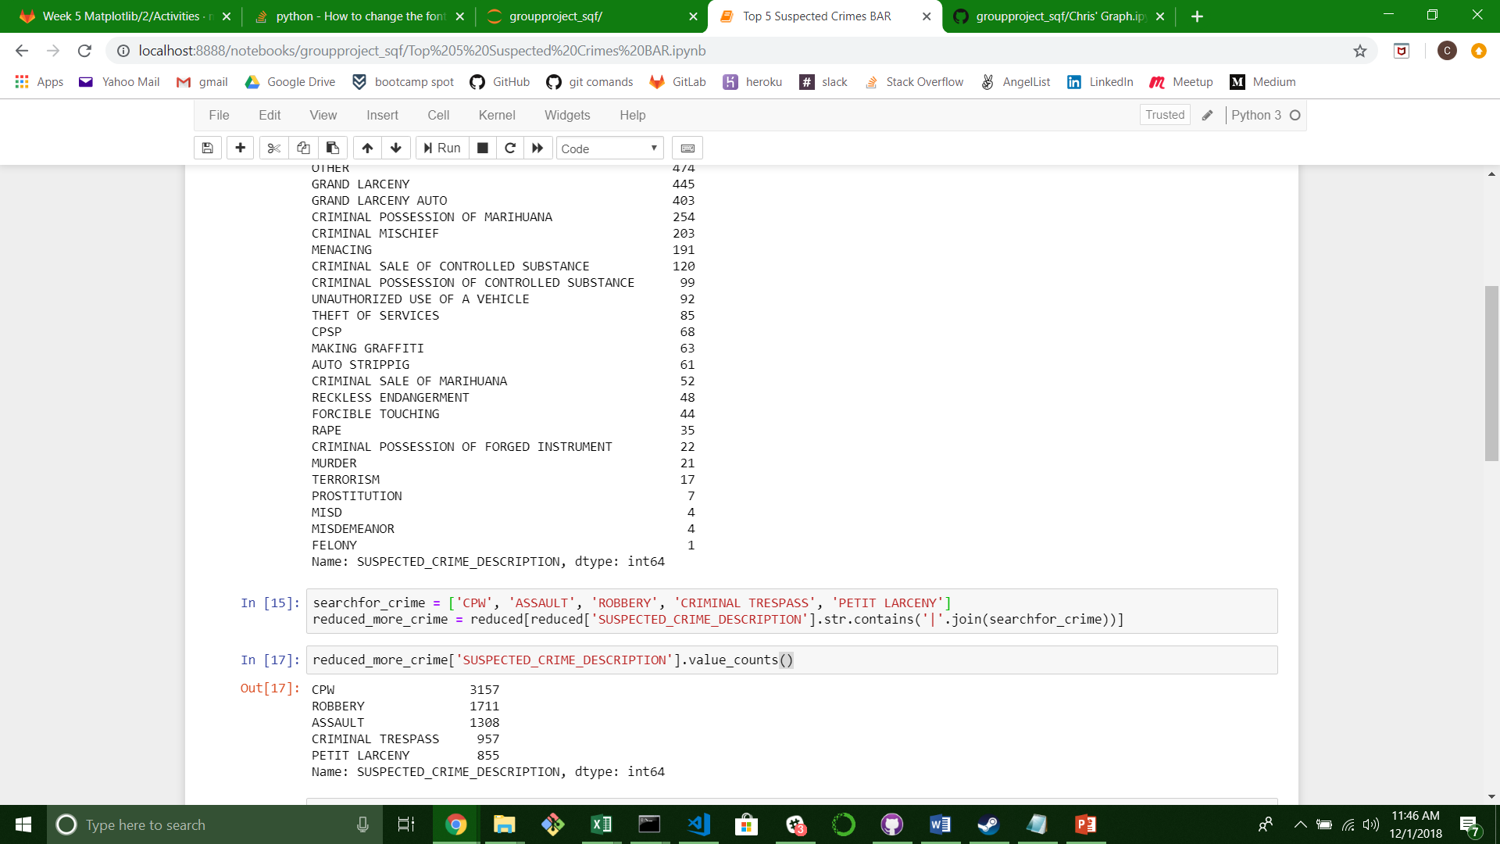
Suspected Crimes
Reducing Suspected Crimes
Pull in df
.value_counts to view all data
Reduce

Slide 6
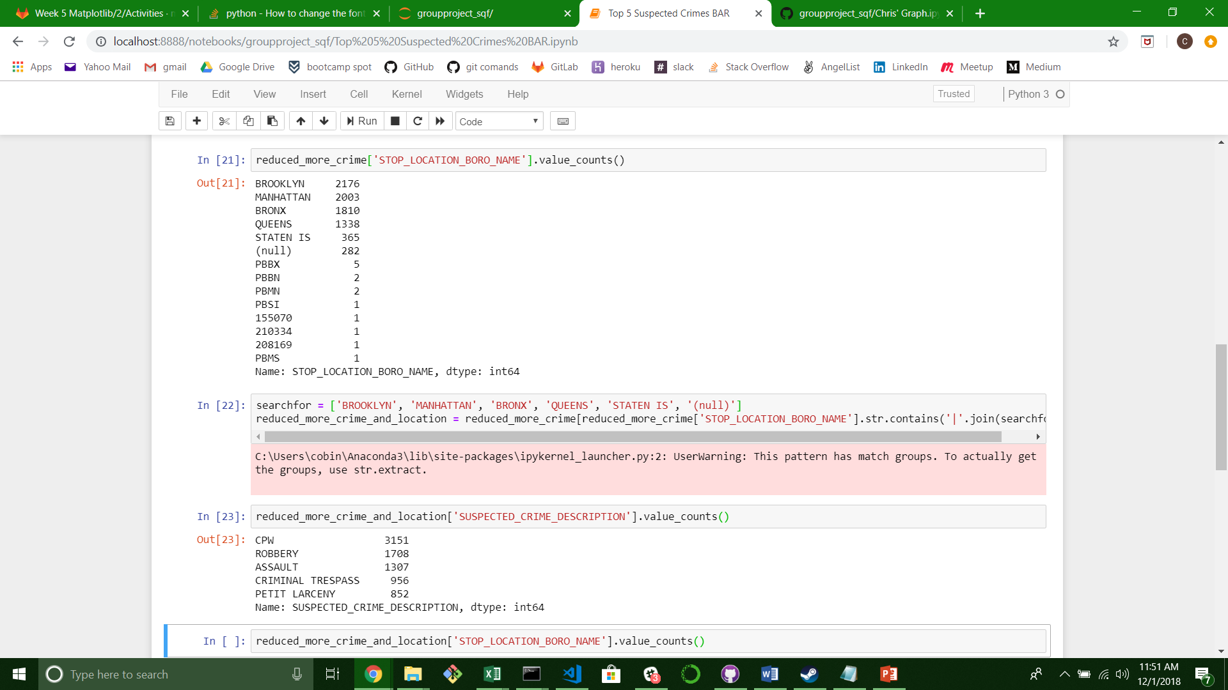
Suspected Crimes
Reducing Boroughs

Slide 7
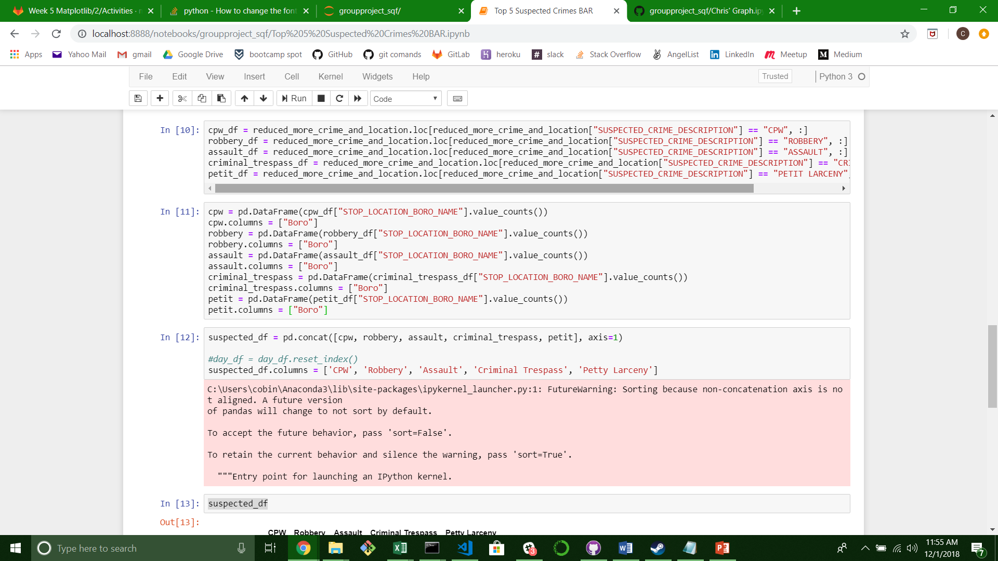
Suspected Crimes
Making Correct Data Frame

Slide 8
Suspected
Whole city

Slide 9
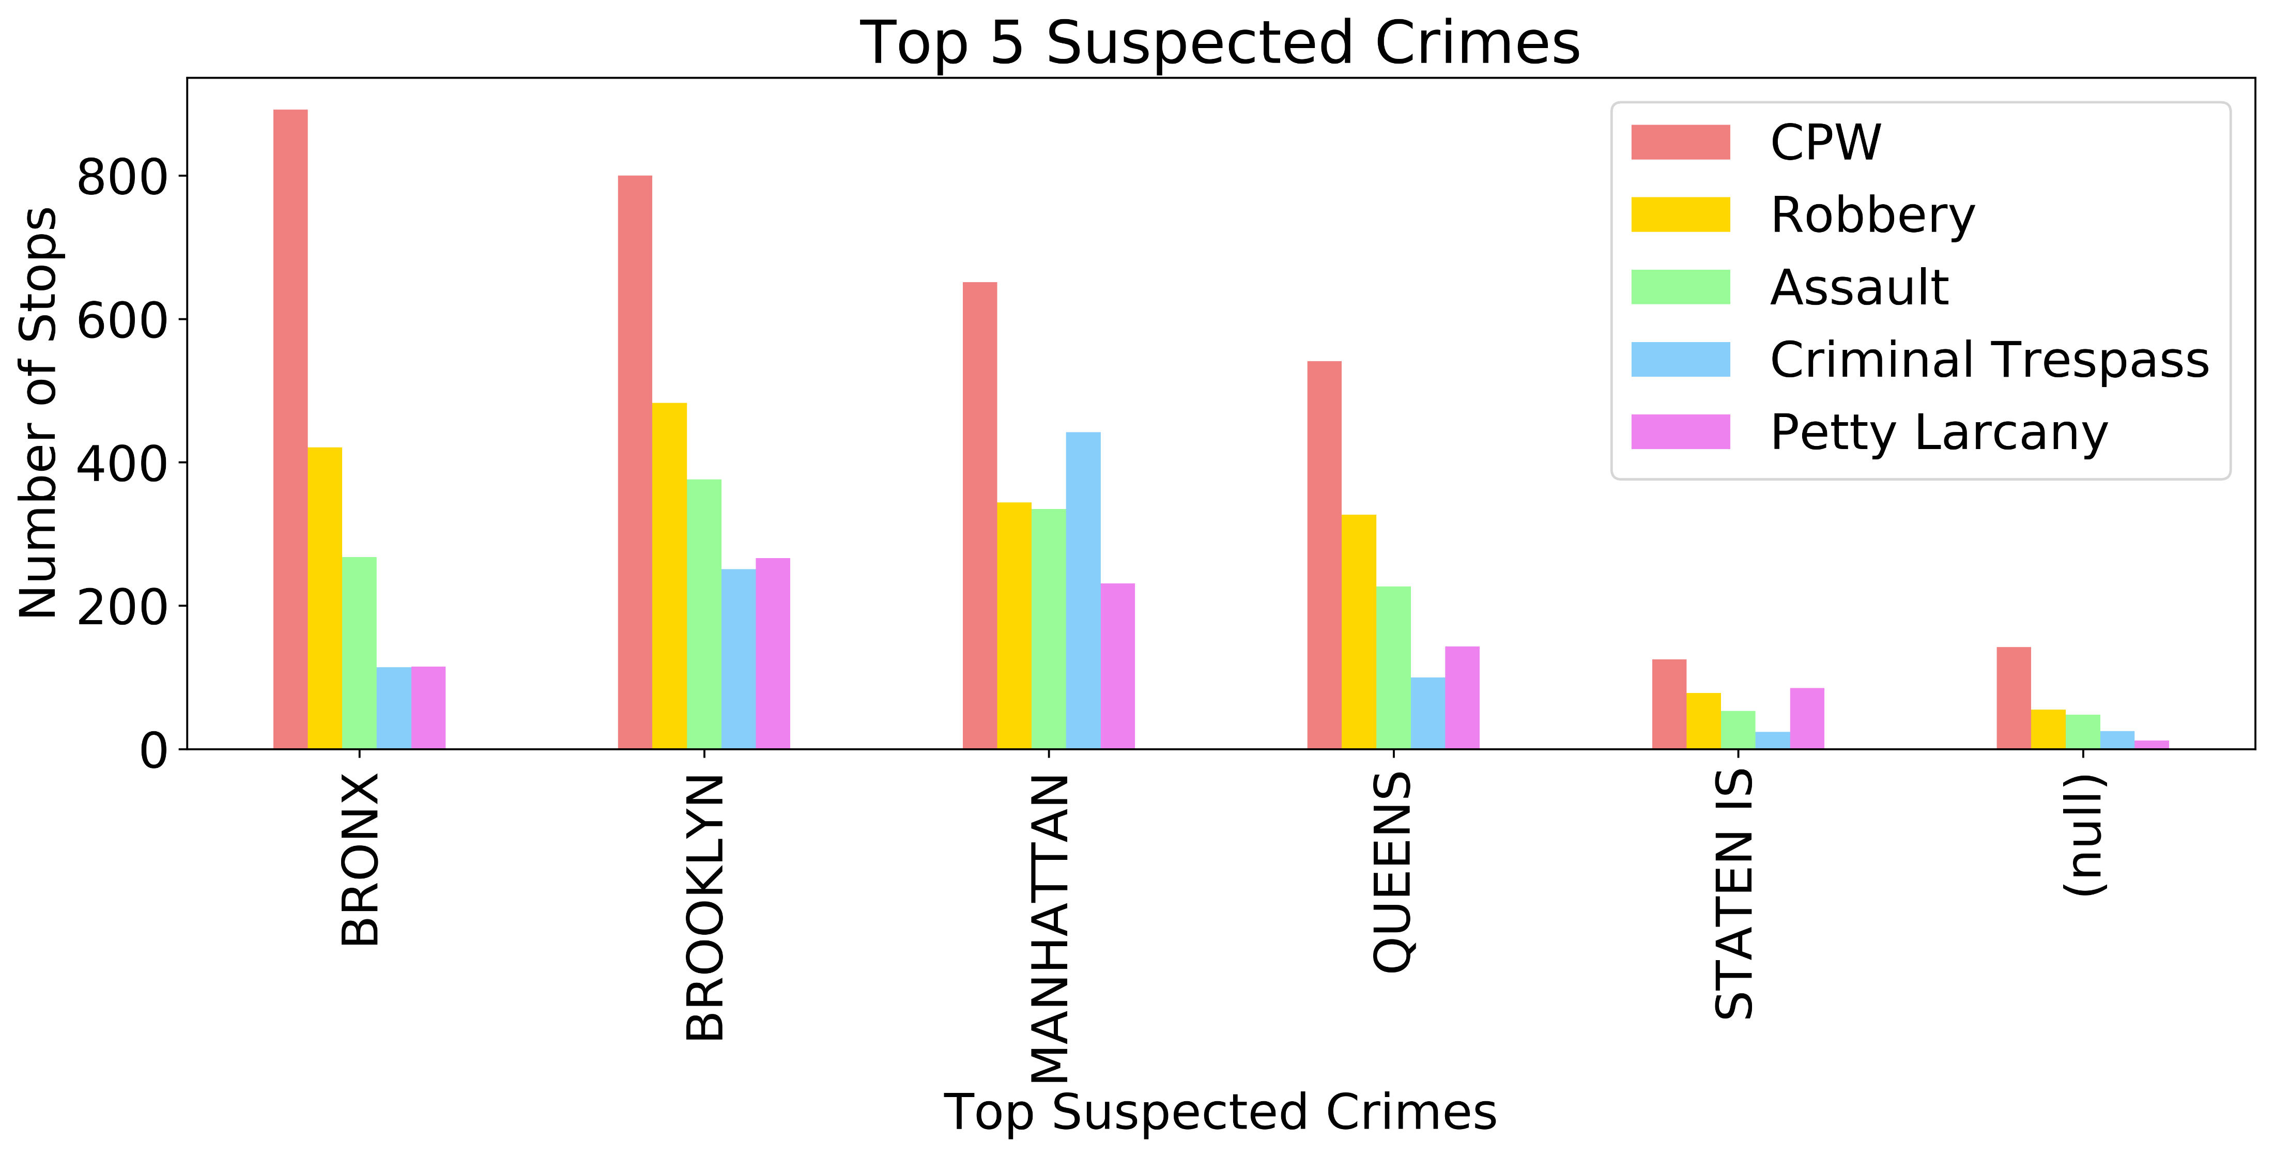
What are people being stopped for?

Slide 10
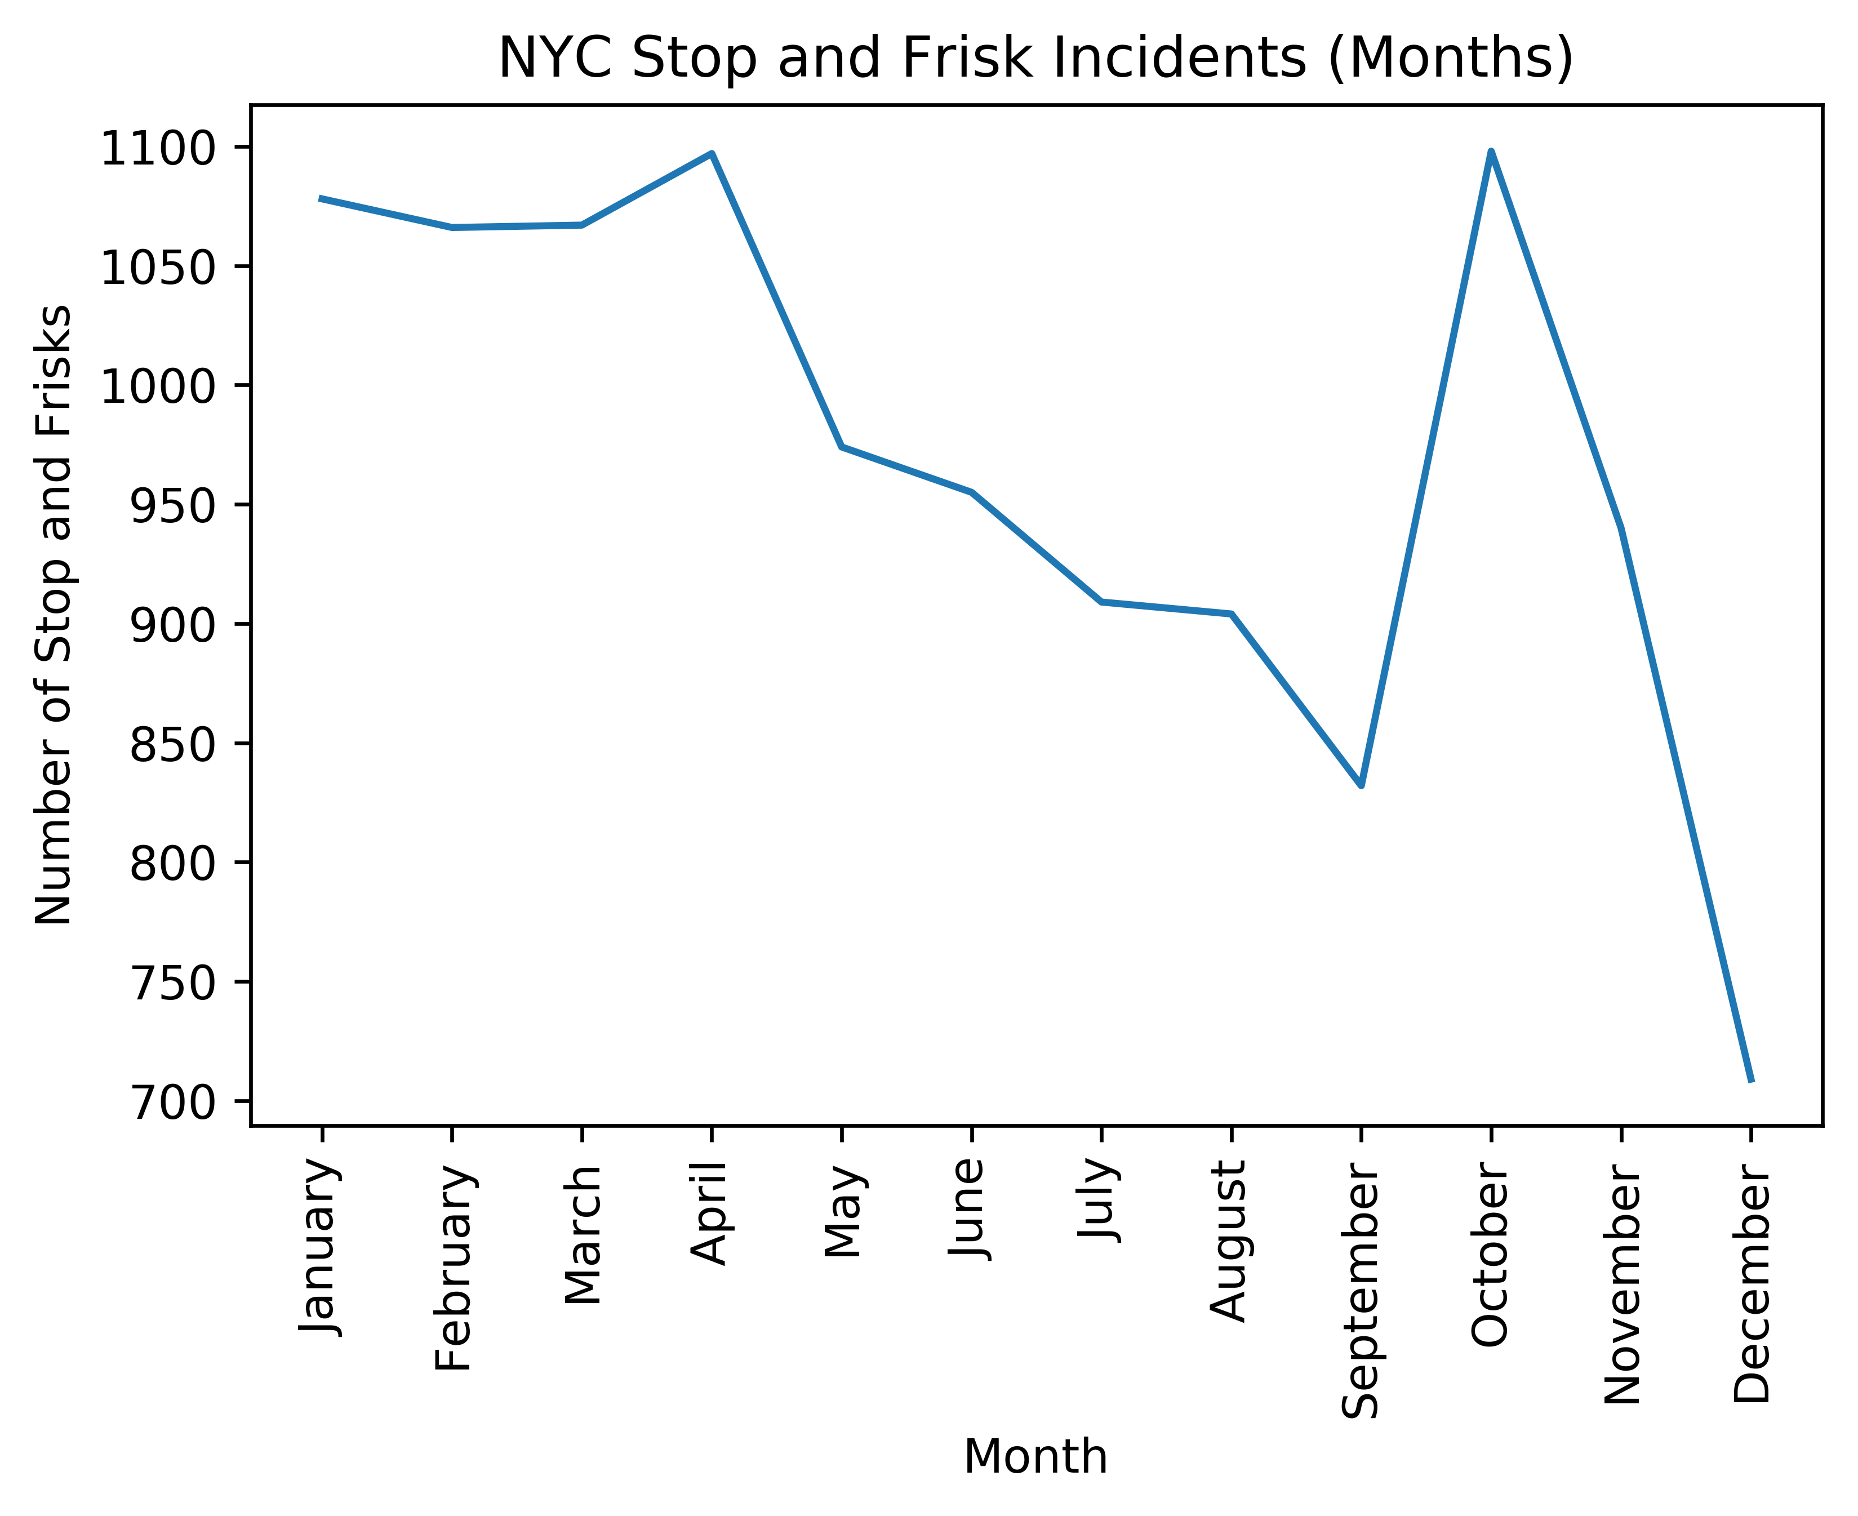
SQF Data Across NYC

Slide 11
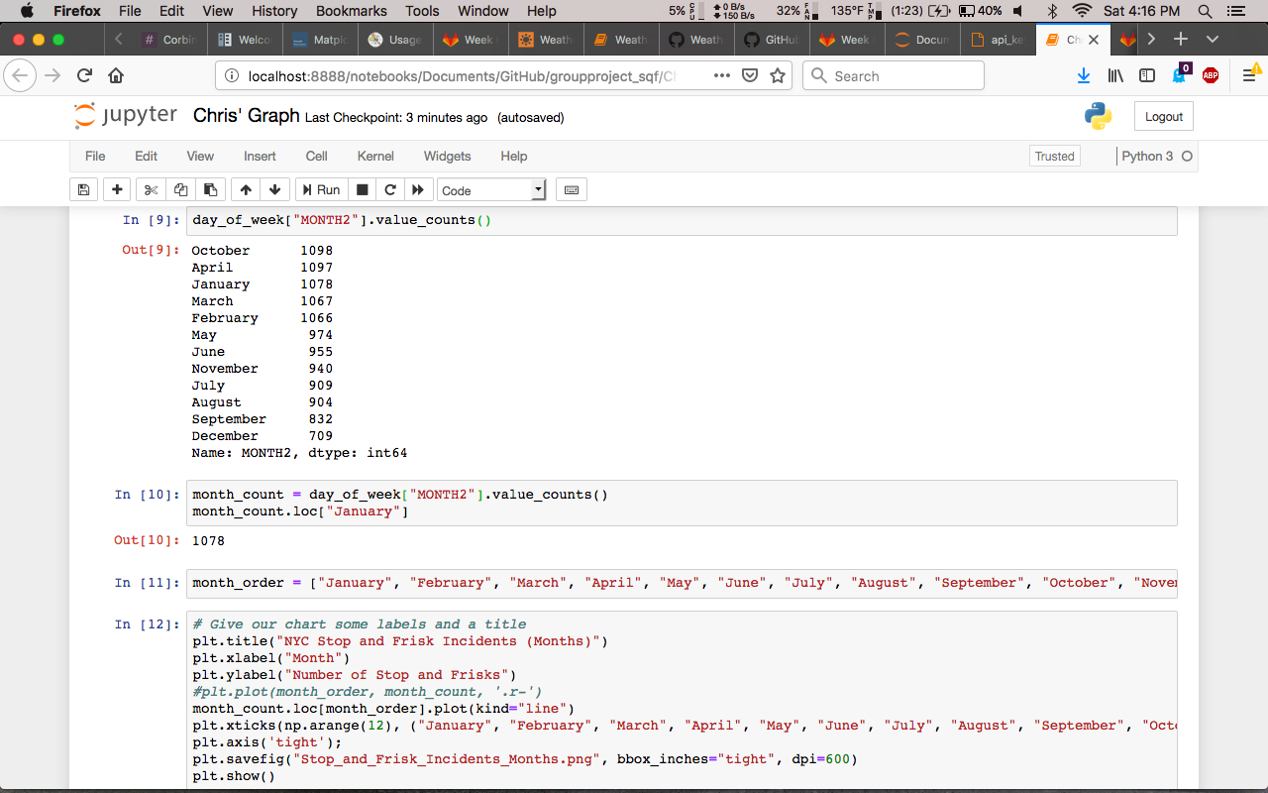
SQF Data Across NYC

Slide 12
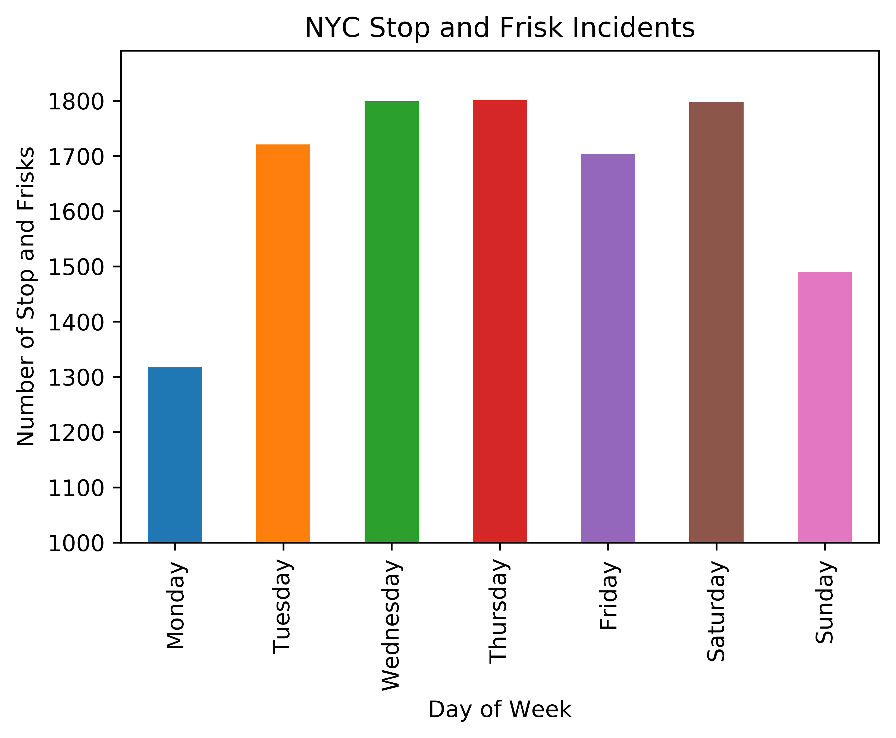
SQF Data Across NYC

Slide 13
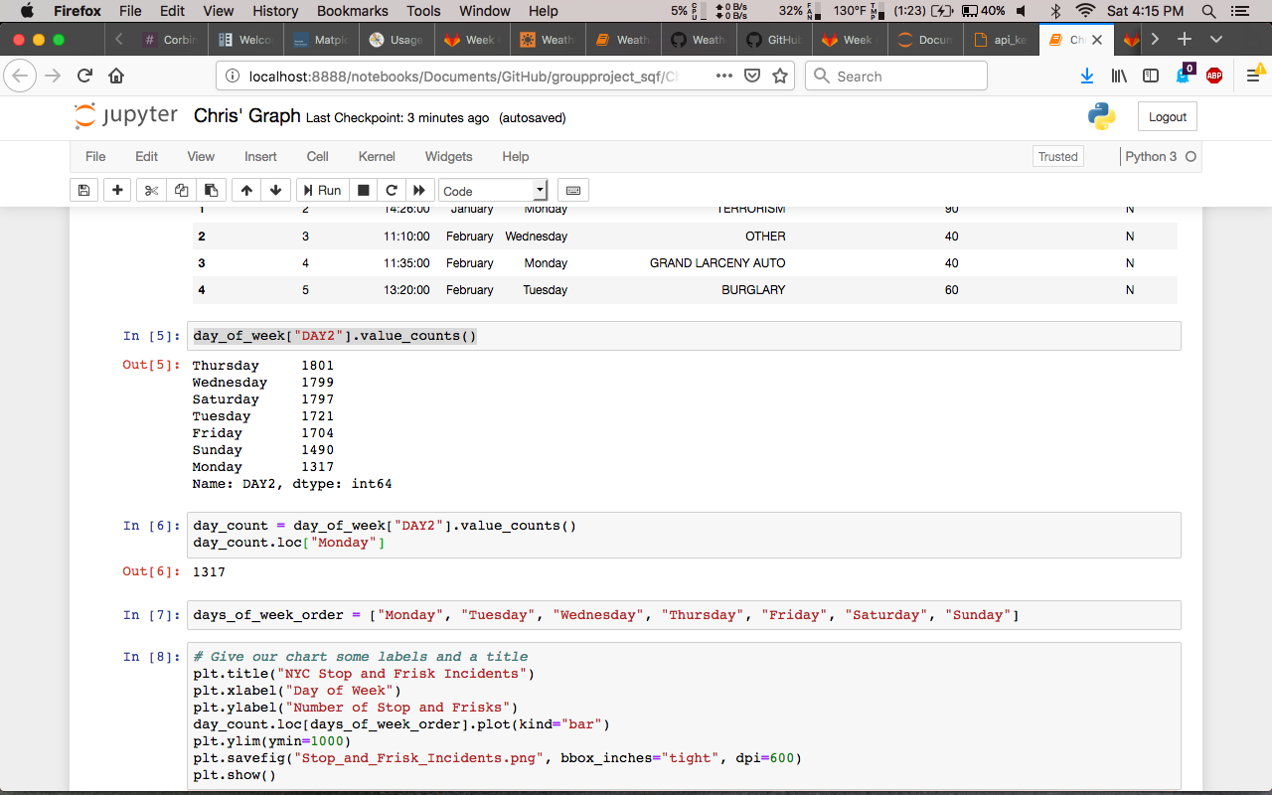
SQF Data Across NYC

Slide 14
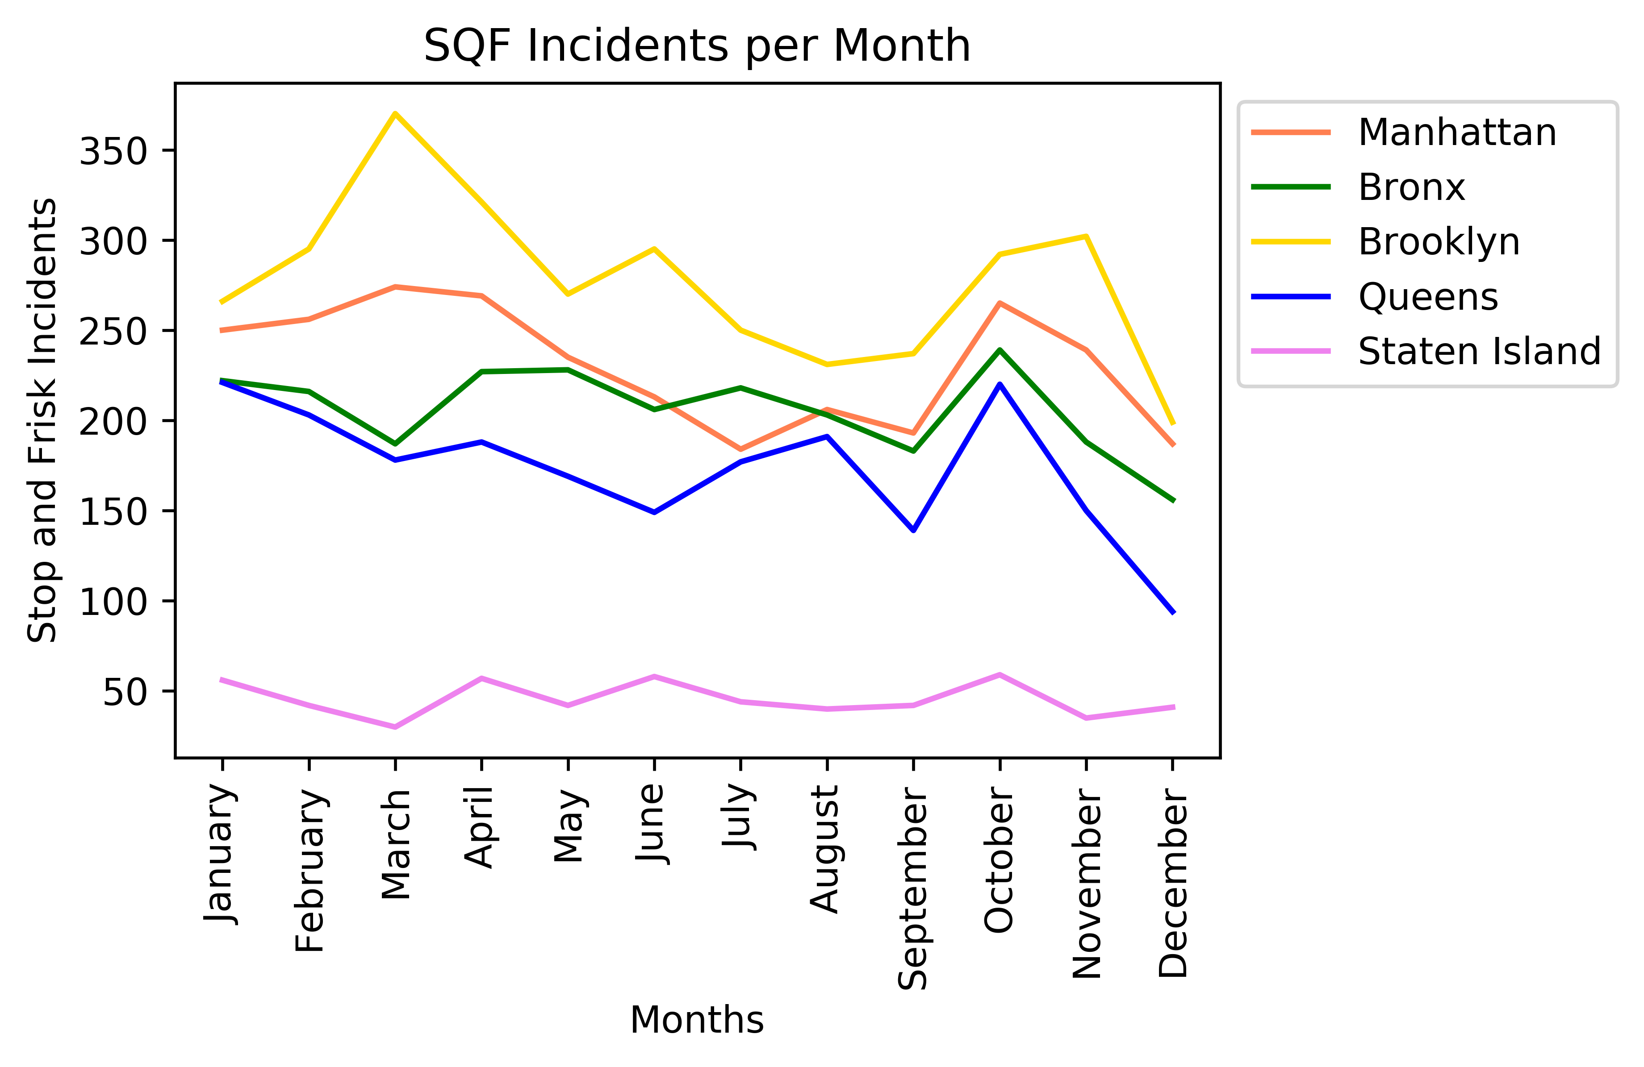
SQF Data Across the 5 Boroughs

Slide 15
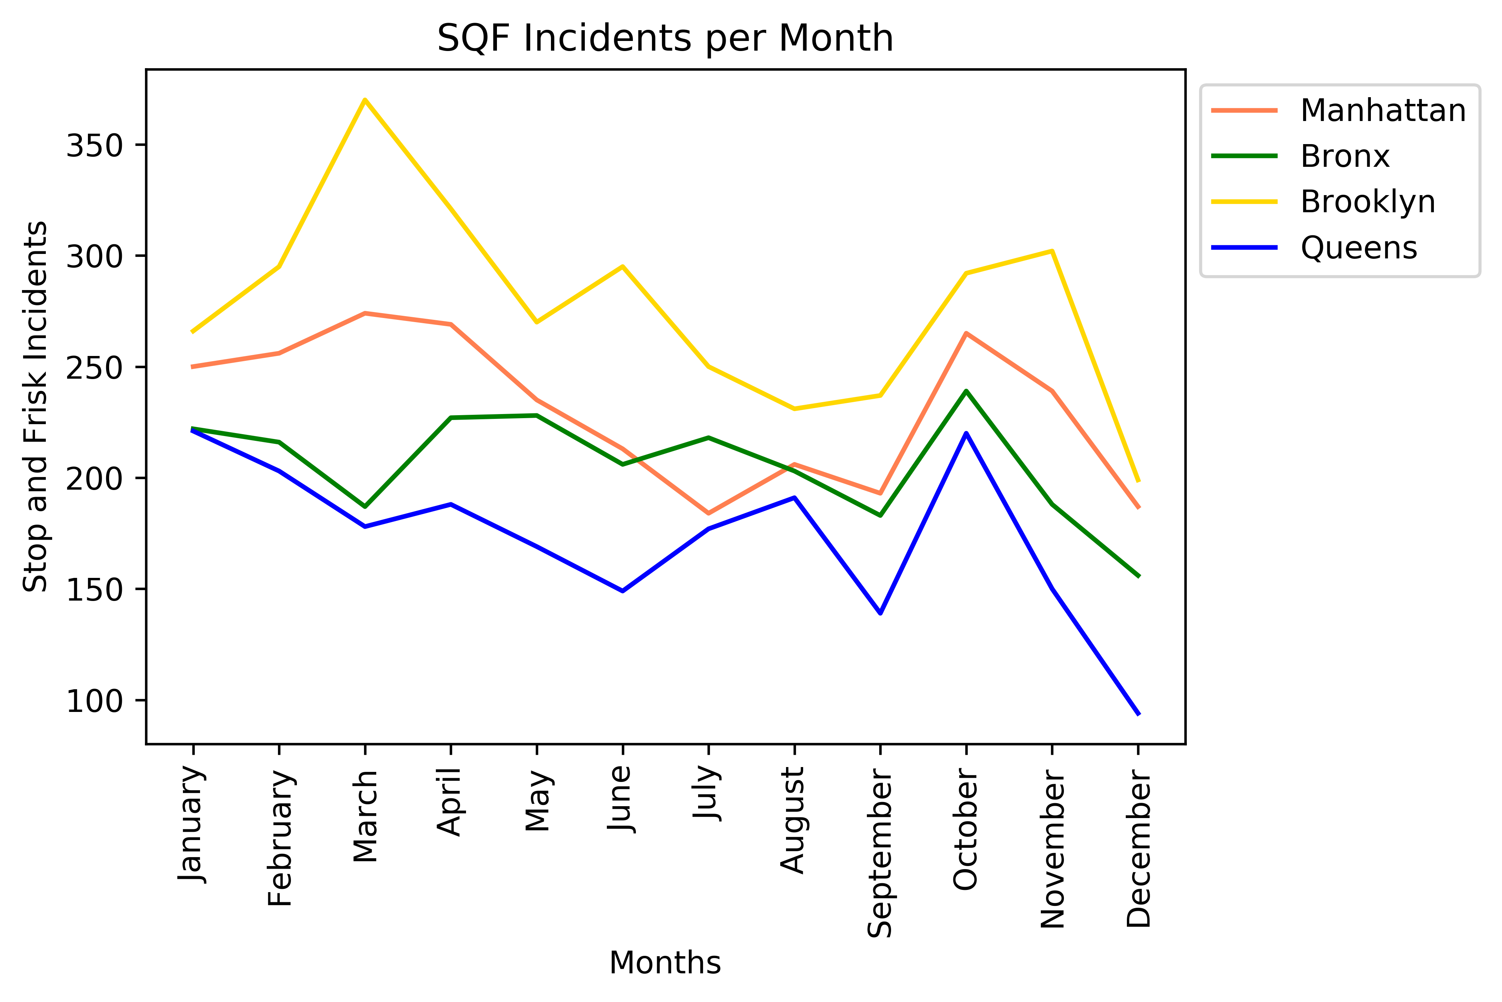
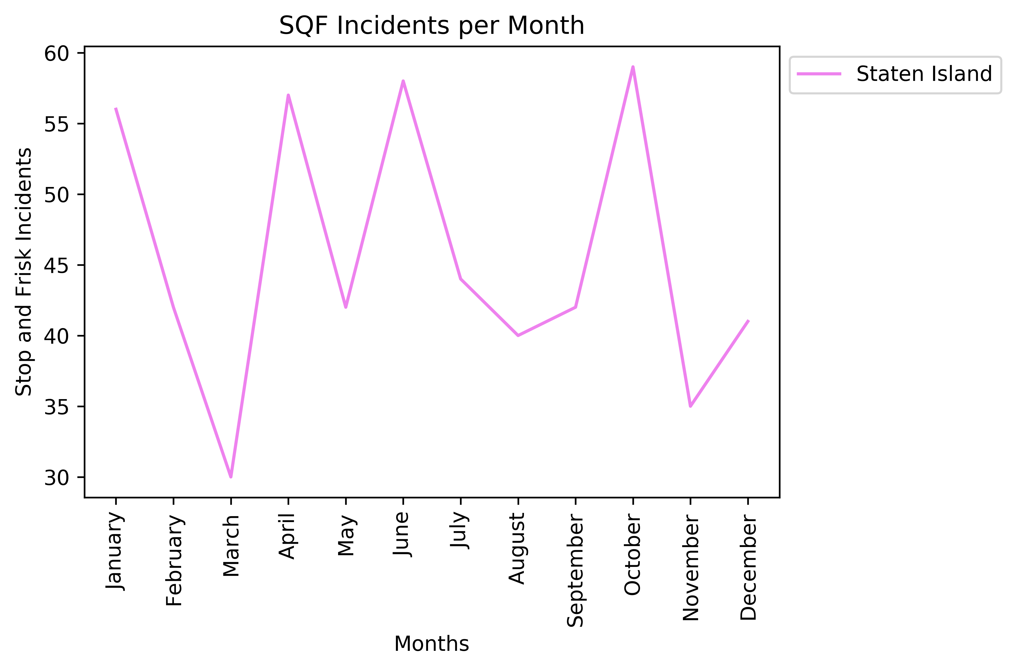
SQF Data Across the 5 Boroughs

Slide 16
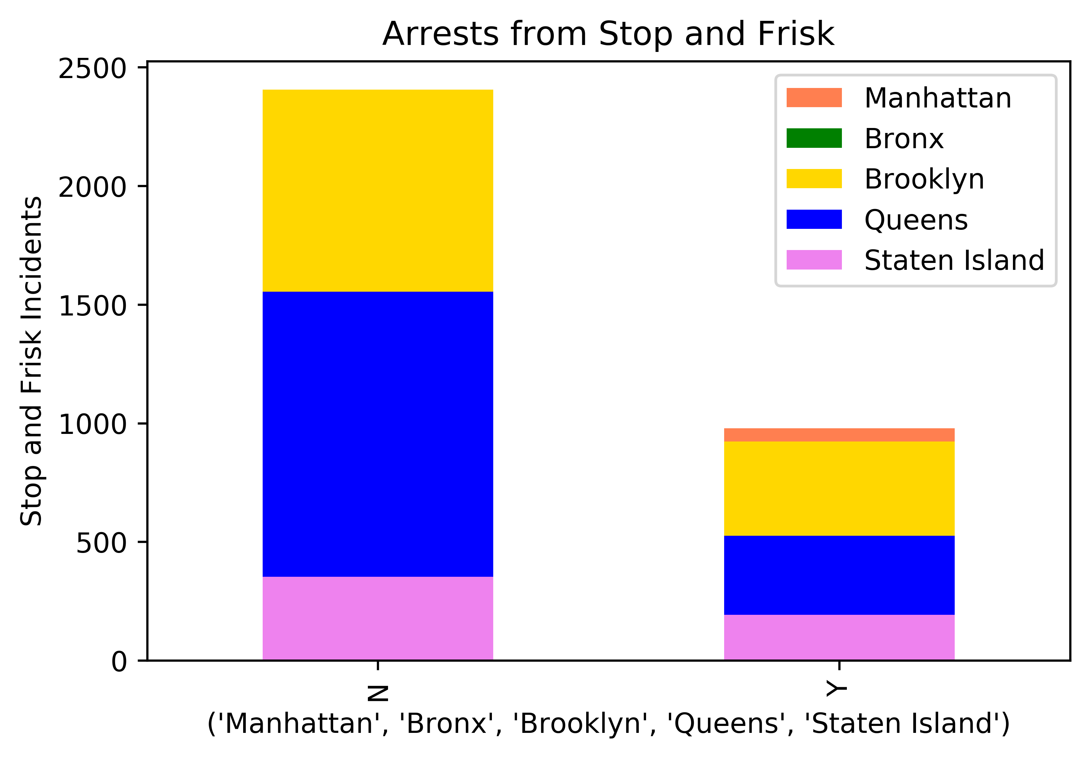
Effectiveness of Stop and Frisk

Slide 17
Presenter 3

Slide 18
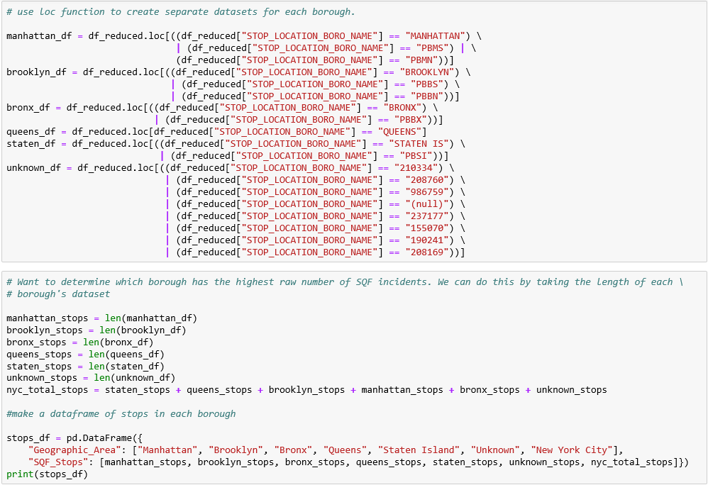
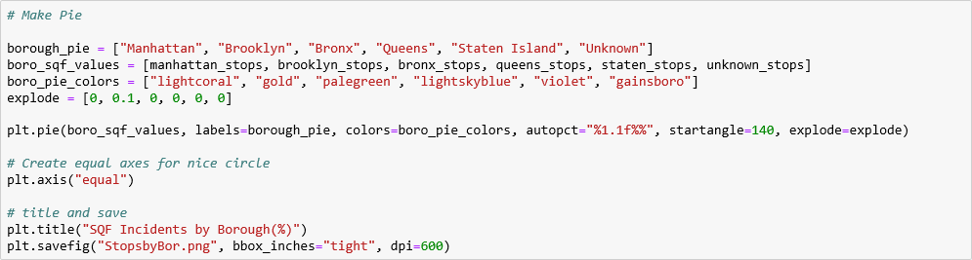
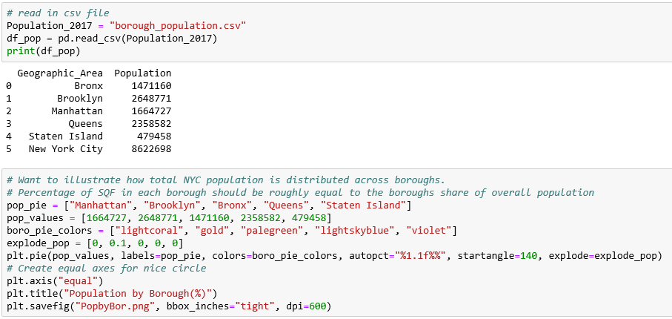
Stop, Question and Frisk Incidents by Borough

Slide 19
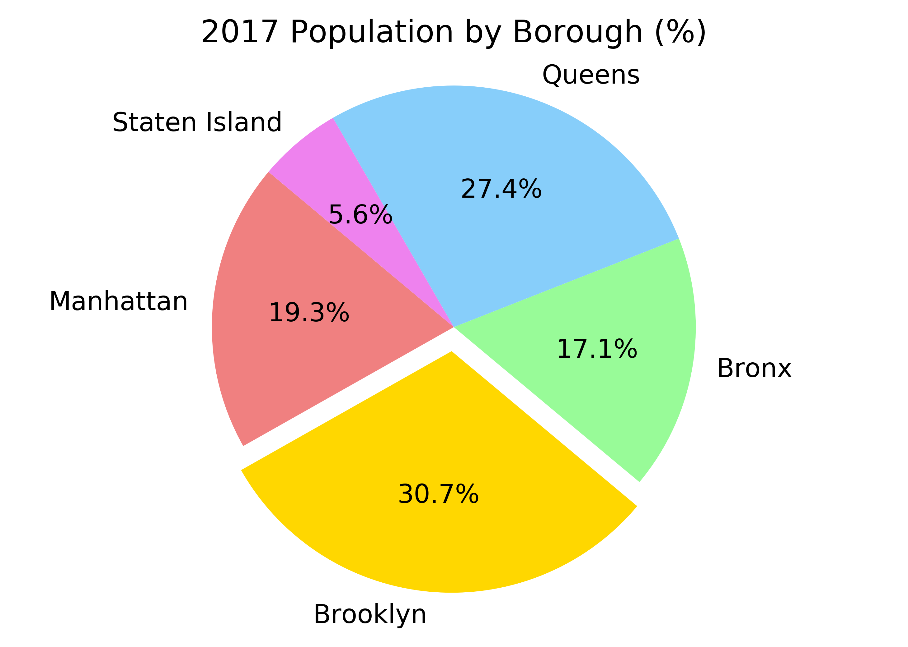
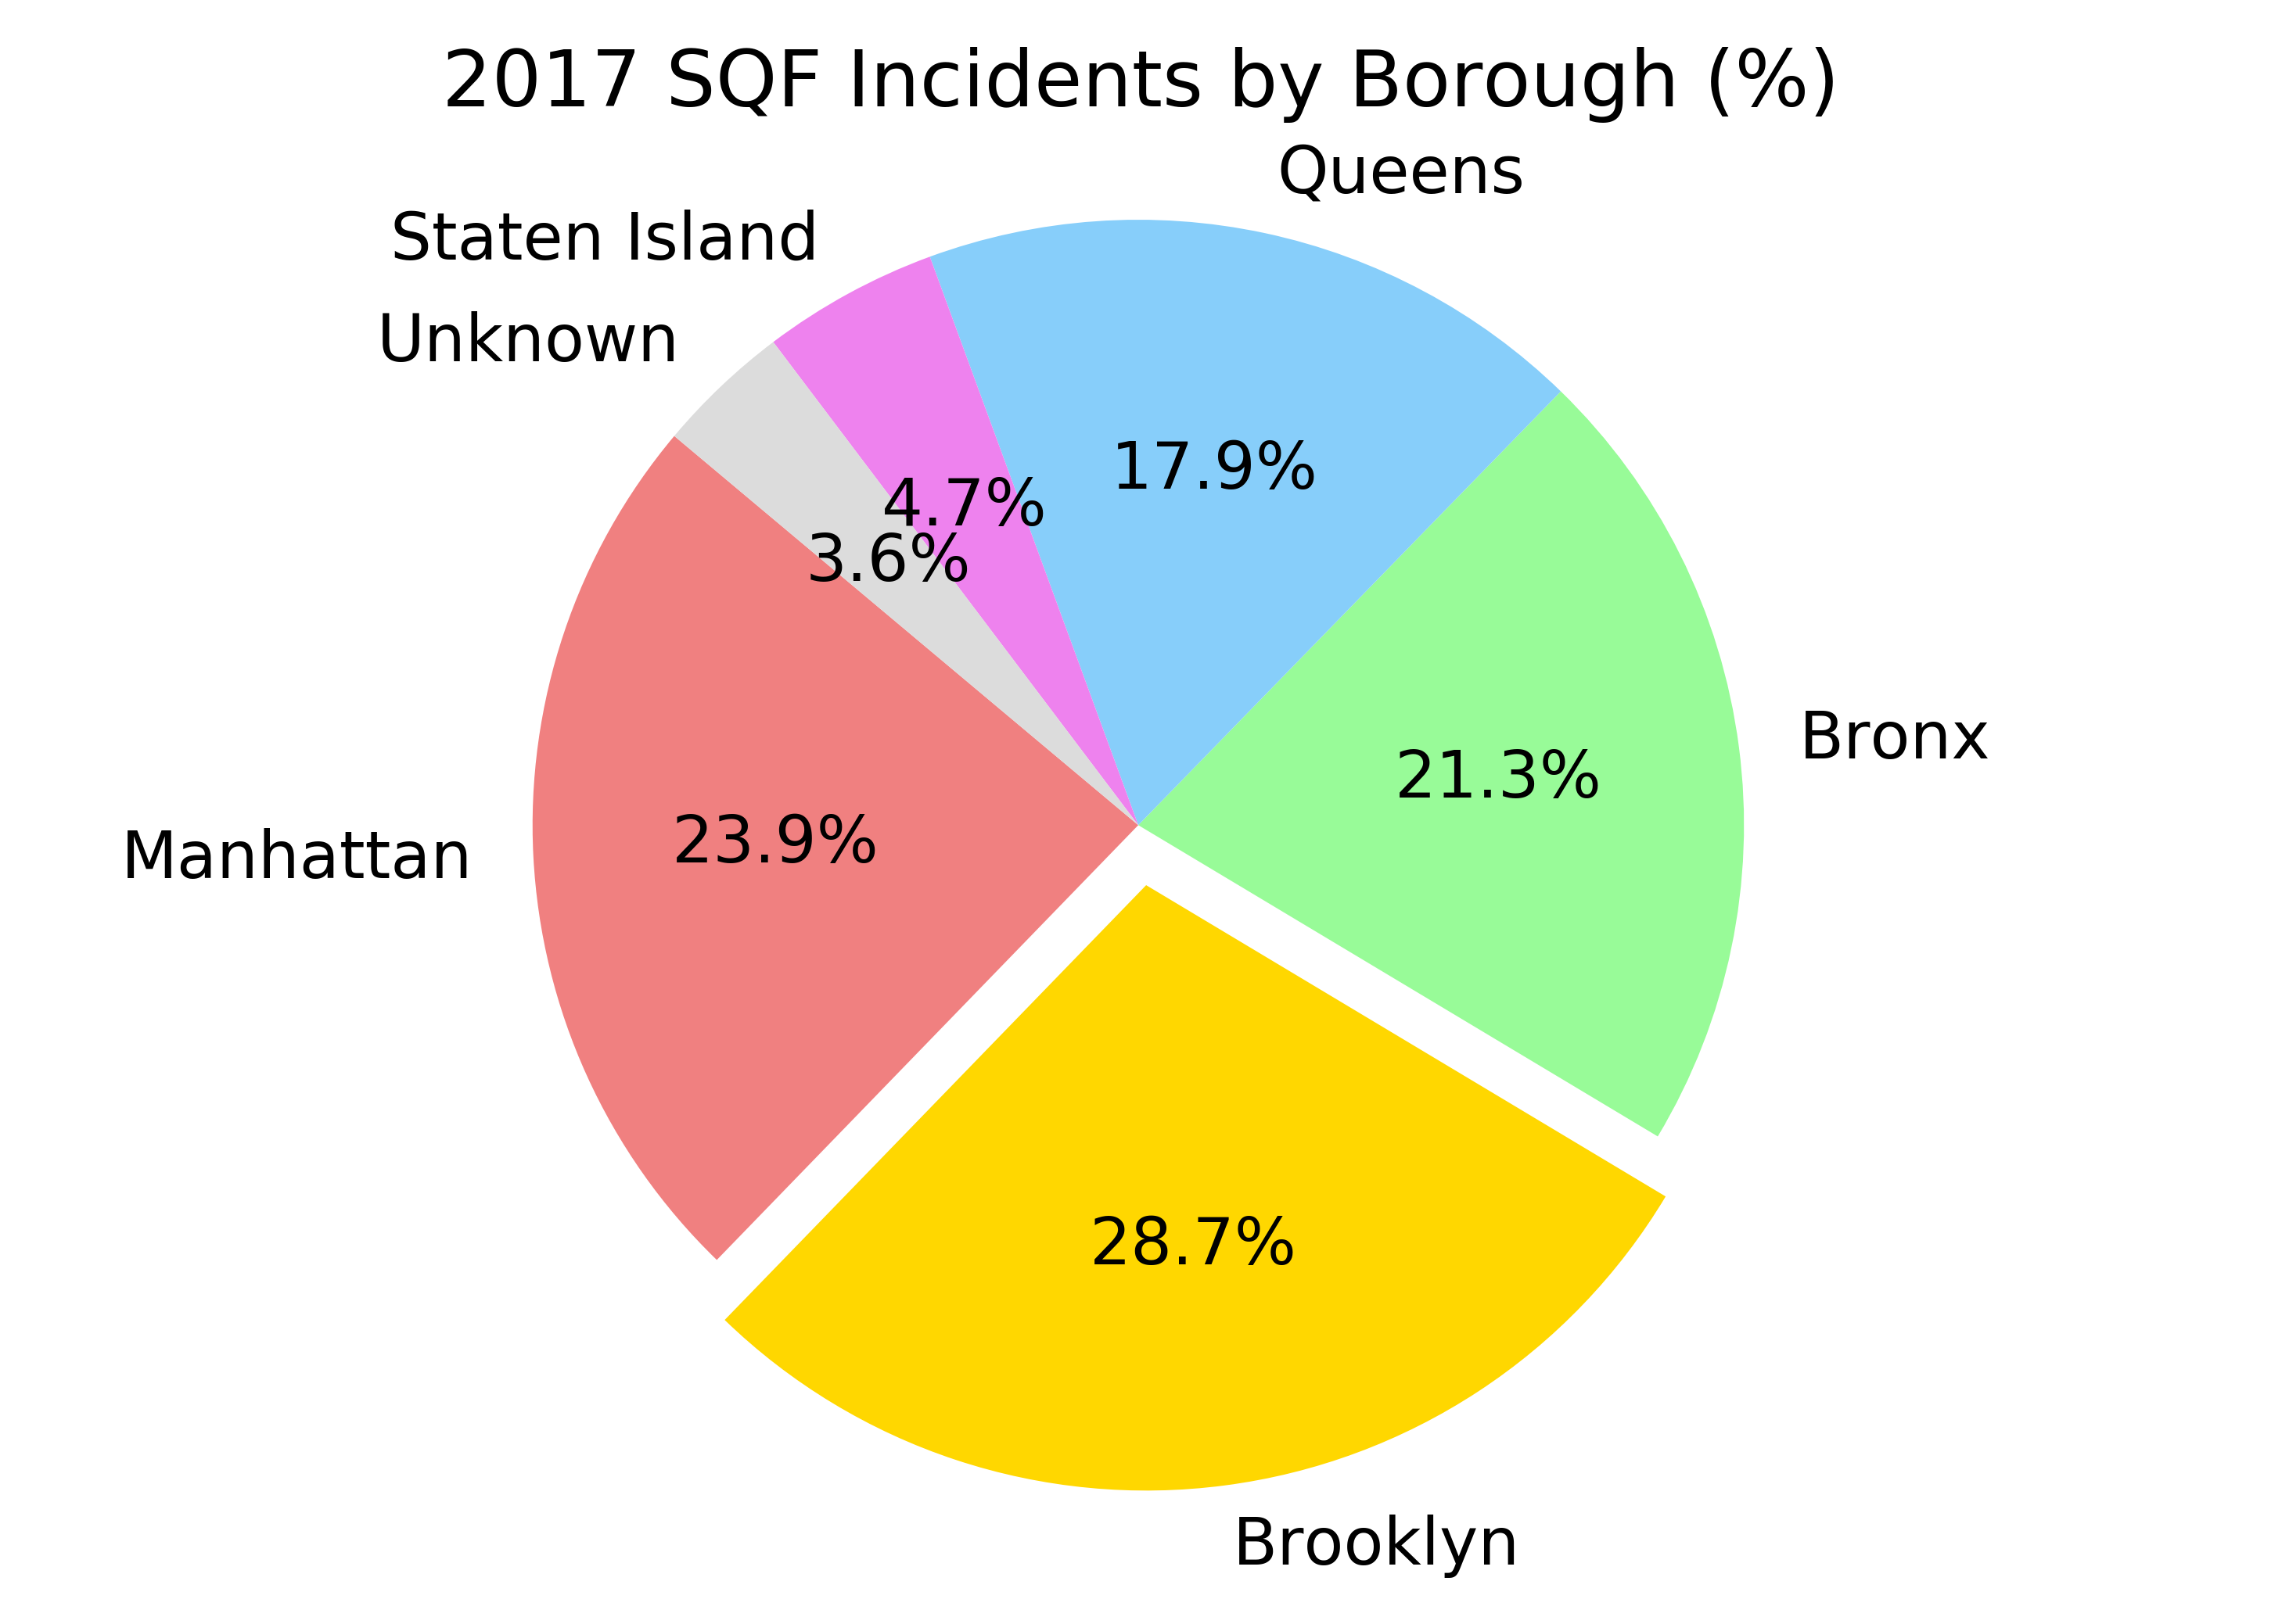
Stop, Question and Frisk Incidents by Borough

Slide 20
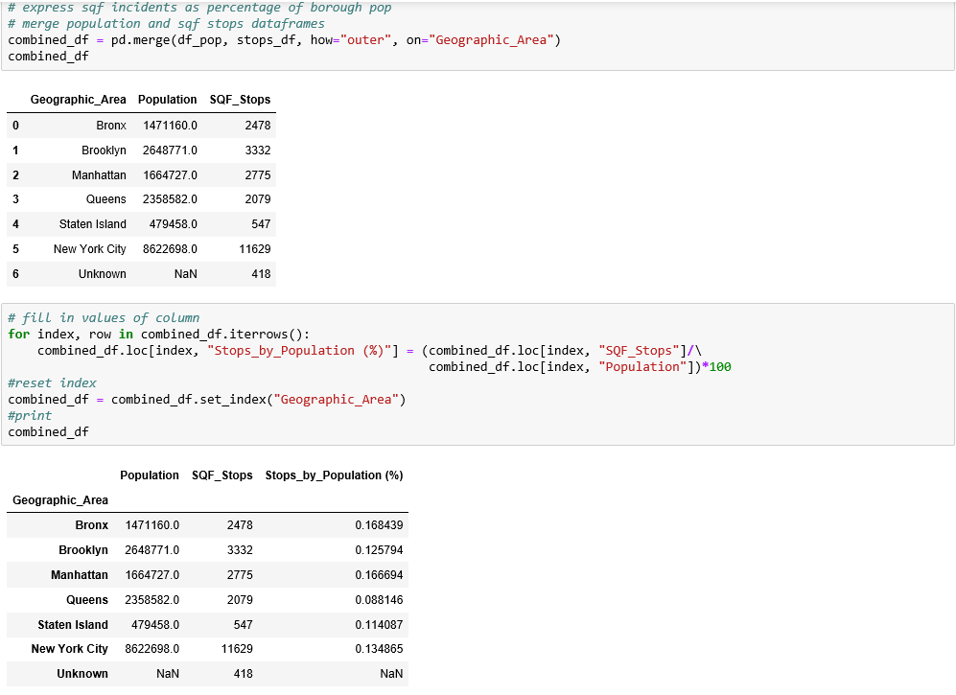
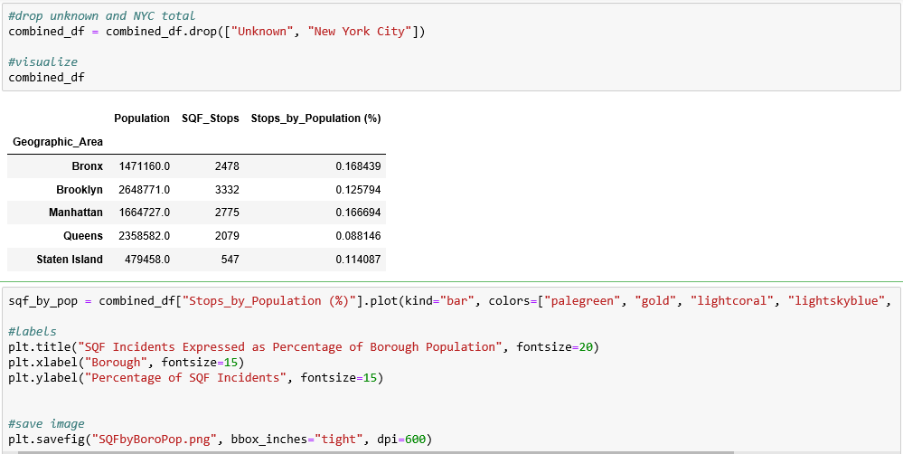
SQF Incidents by Borough Population

Slide 21
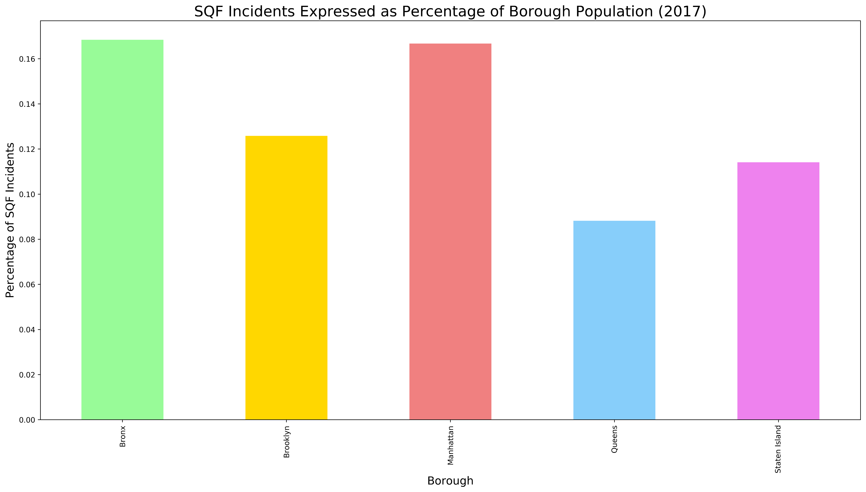
SQF Incidents by Borough Population

Slide 22
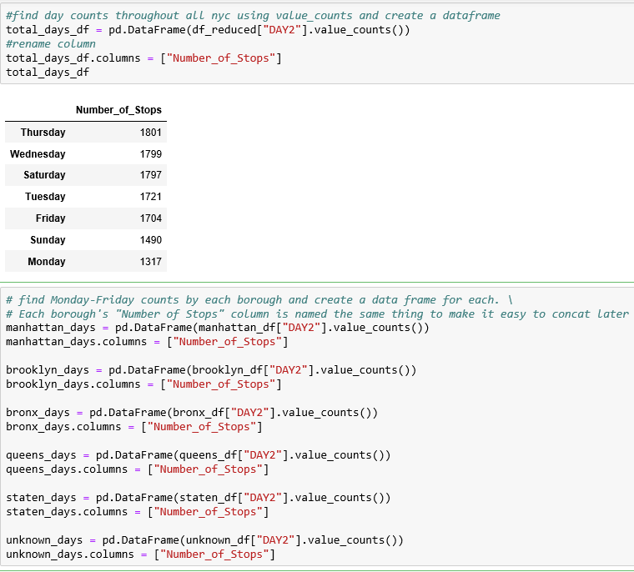
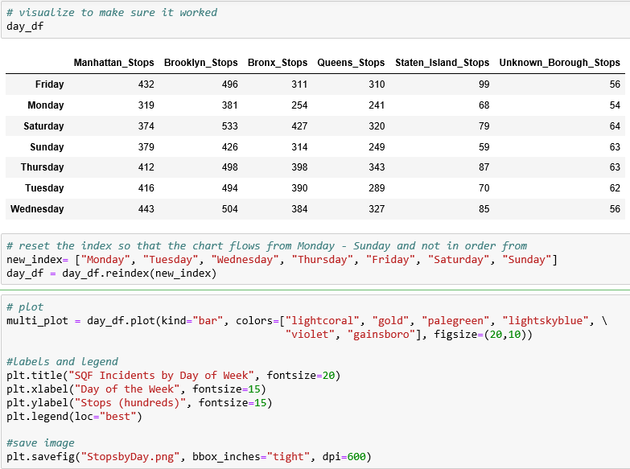
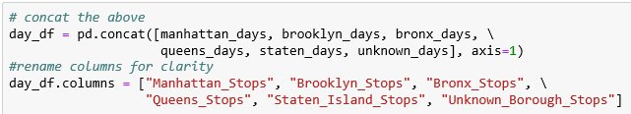
Stop, Question, and Frisk Incidents by Day

Slide 23
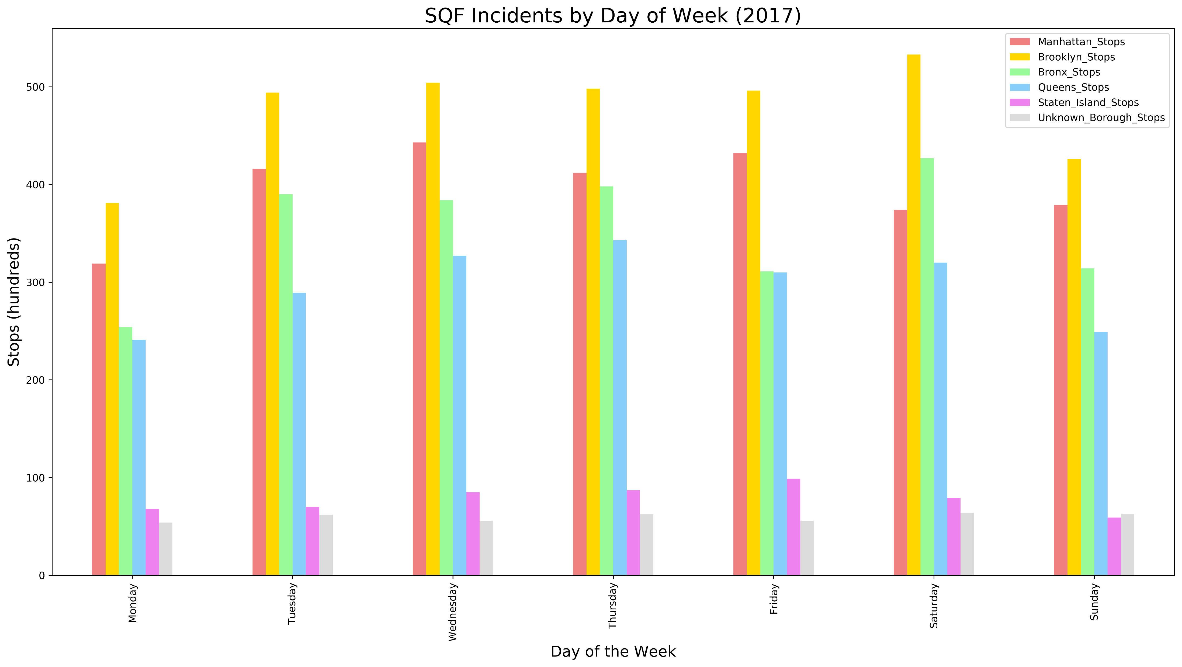
Stop, Question, and Frisk Incidents by Day

Slide 24
Findings
Brooklyn has the highest raw number of SQF incidents in 2017.
However, when the number of SQF incidents in each borough is expressed as a percentage of borough population, the Bronx and Manhattan have the highest rates.
SQF tactics are most frequently used when an individual is suspected of criminal possession of a weapon.
This is followed by robbery, assault, criminal trespassing, and petty larceny.
SQF incidents in NYC declined steadily between May and September, spiked in October, and declined precipitously in November and December.
Each borough roughly mirrors the overall NYC trend, but there are a few exceptions. Notably, Brooklyn experiences a large increase in SQF incidents in March that is not replicated in the other four boroughs, or in the overall trendline.
29.7% of SQF incidents lead to an arrest.
Staten Island has the highest arrest rate, at 35.3%
Queens has the lowest arrest rate, at 25.3%

Slide 25
Discussion
Our hypothesis that SQF incidents would spike in the summer proved to be incorrect - we actually saw a decline during the summer months.
We saw an unexpected decline in SQF incidents in November and December
Potential Explanations:
Police staffing levels
College students leave the city during the summer and holiday season

Slide 26
Ideas for Further Research
Explore the reason for the summer and holiday decline by obtaining a dataset of NYPD staffing levels.
What predicts the use of force?

